Slide 1
Tracking the Compton Electron
Matt Wilson
16/04/13

Slide 2
Introduction
Background and Motivation
Feasibility Study
Deliverables
Future Plans

Slide 3
Background and Motivation
Compton Cameras have the potential to improve gamma-ray imaging compared to collimated systems.
Compton Cameras will be more expensive than existing technologies so an improvement has to be demonstrated:
3D position
Spatial Resolution
Reduced Dose

Slide 4
Background and Motivation
Uncertainties in the Compton reconstruction mean many events are needed to accurately measure a source location.
Tracking the direction of the Compton electron could reduce the uncertainties → increase efficiency
This project will:
measure how accurately an electron needs to be tracked to get the efficiency increase.
ascertain if we could build the technology to track the electrons with sufficient accuracy.
seek funding to build the technology in the future.

Slide 5
This Project
GATE based simulations to identify Compton Electron ranges and distribution for different medical isotopes, security imaging and nuclear decommissioning energies.
Simulate a scattering detector measurement of the electron interaction → Si detector with different thicknesses, pixel size and energy resolutions (?)
Quantify what improvements in performance are gained for different scenarios.

Slide 6
This Project
Study of what the end user requires:
Compare with current state of art
Discuss with potential users (B. Hutton shown interest)
First study of feasibility of building the scattering detector
Detector specifications (thickness, pixels, leakage...)
ASIC design → pixel size, dE, dt, synchronisation...
DAQ design → data rates/volumes, processing...
Data processing → reconstructions

Slide 7
Deliverables and Future Plans
Milestones that I have to report on:
1. Recoil electron study – preliminary physics report
Energy, range → signal generated on a pixel.
2. Recoil electron report and recommendations
ASIC spec, efficiency gains, end users, funding.
At the end of 2013 want to be able to say that what we would want to build, improvements it would give and who wants to have it.
Seek funding for large project to build a camera
Seek STFC internal funding for test ASICs and testing

Slide 8
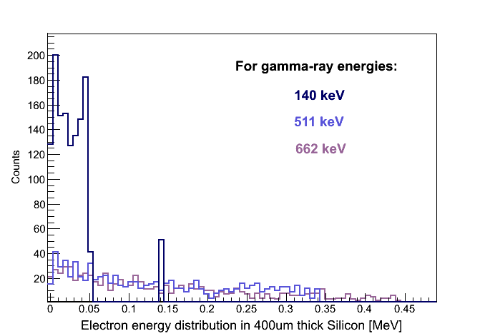
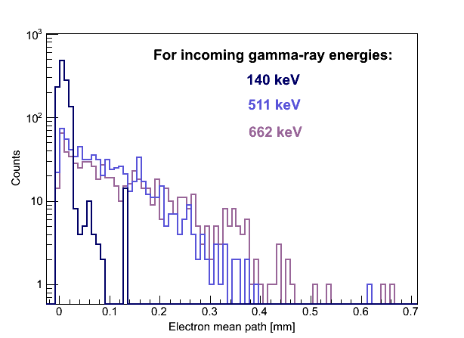
Preliminary Work
Marc has conducted a first simulation at 140keV, 511keV, 662keV.
Does E field significantly effect e- track?

Slide 9
Proposed Plan
Collaboration with Liverpool to complete the simulation and feasibility study.
STFC and Liverpool agree first detectors and geometries to simulate.
Liverpool mainly doing simulations, Matt and Marc helping and supporting.
Engage with ASIC designers, DAQ developers and end users.
Seek funding to build as much as possible.

Slide 10
Outcome of this meeting
Understand STFC project commitments.
Update on Liverpool simulations to date.
Agree what and how we would do simulations.
Set some short term objectives.
Identify target applications/users for technology pull for future funding – stakeholders.
Arrange a regular meeting?
Anything I’m missing...?

